Slide 1
Inversion of Control Containers
&
Dependency Injection Pattern
With “Injector”
Notes:
Presentacion personal
Presentacion InvisibleBits
Presentacion Charla

Slide 2
Summary
From SOLID to Inversion Of Control Containers
Code Example Explanation
Example that violates DI principle
Example that respects DI principle
Example that use IoC Containers
Questions
Notes:
Exlicar los putos que vamos a ver un poco de estructura de la charla, dejar claro que sera muy hands on

Slide 3
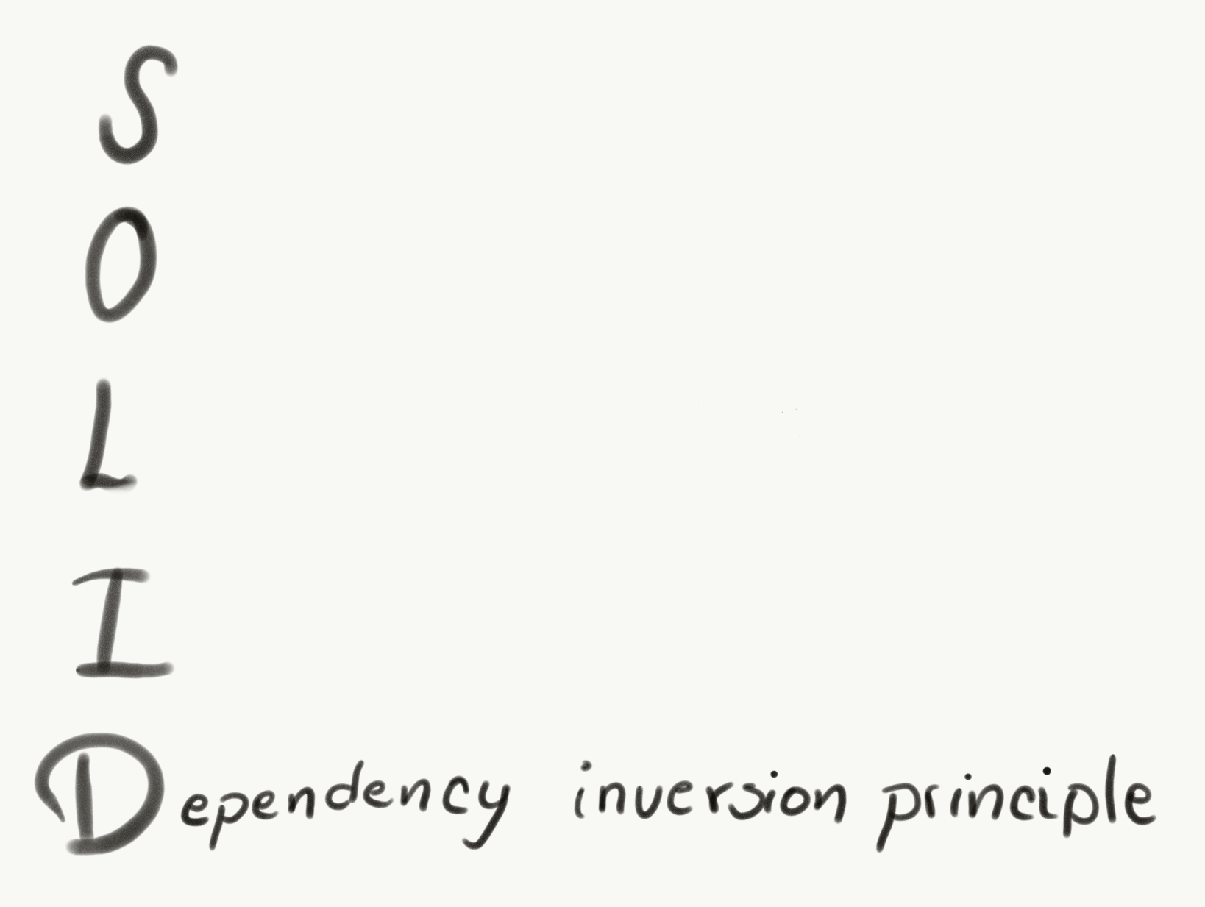
From SOLID
to
Inversion of Control Containers
High-level modules should not depend on low-level modules. Both should depend on abstractions (e.g. interfaces).
Abstractions should not depend on details. Details (concrete implementations) should depend on abstractions.
Notes:
Que es Solid muy por encima, y por que es importante …
Vamos a centrarnos en el principio de inversion de dependencias y como se liga a la tactica de inversión de control haciendo y la tecnica de inyeccion de dependencias.

Slide 4
Code Example Design
Notes:
Muy brevemente vamos a analizar como esta estructurado el codigo de ejemplo que usareos para explicar todo esto

Slide 5
Architecture
Domain Layer: Contains the state and the behaviour of the domain.
Application Layer: Coordinates application activities and creates and accesses domain objects.
Infrastructure Layer: Supports other layers, contains specific implementations of code for code that has to interact with components outside our system.
Notes:
Tenemos 3 layers ->

Slide 6
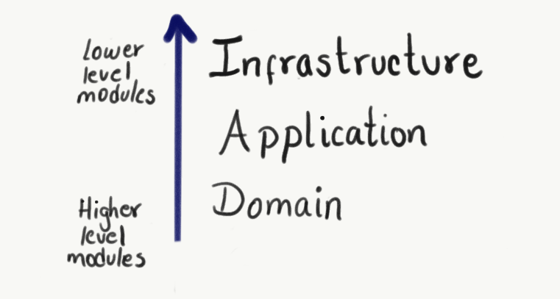
Notes:
Ligarlo con la perimara diapo

Slide 7

Code Example

Slide 8
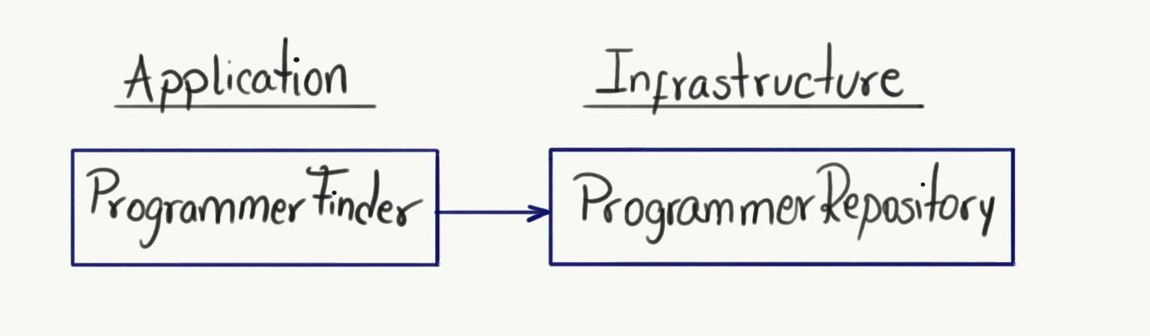
Dependency inversion
Violation

Slide 9
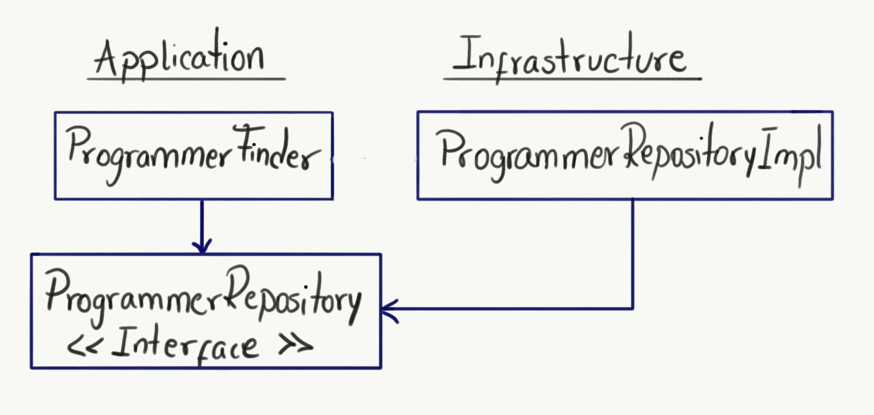
Dependency inversion
Solution

Slide 10
Code Example

Slide 11
Injector

Slide 12
Code Example

